Slide 1
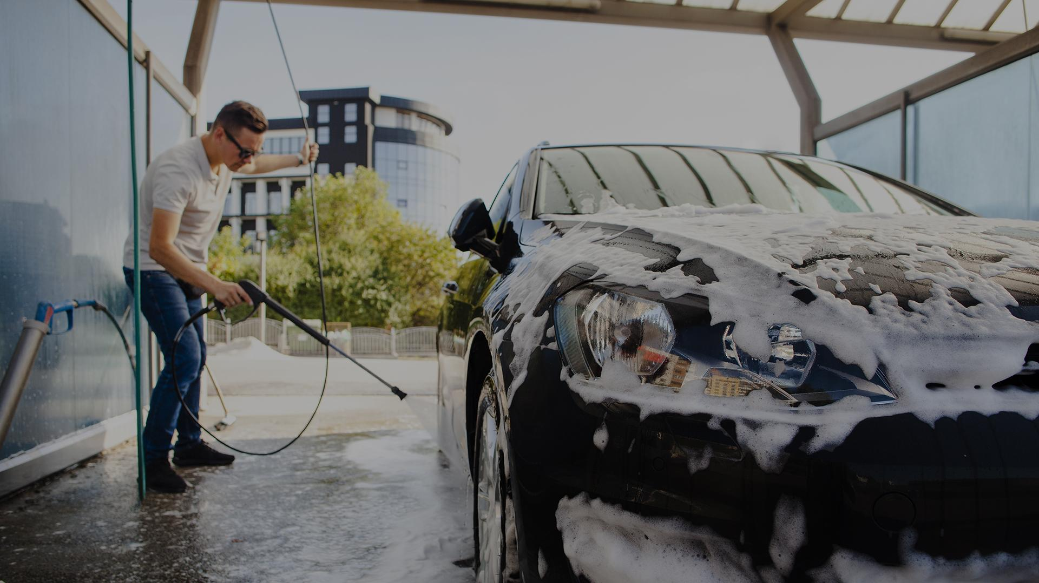
INTERIM PRESENTATION
Supervisor : Ms. S. Thrimahavithana
Co-supervisor: Mr. Roshan Abeyweera

Slide 2
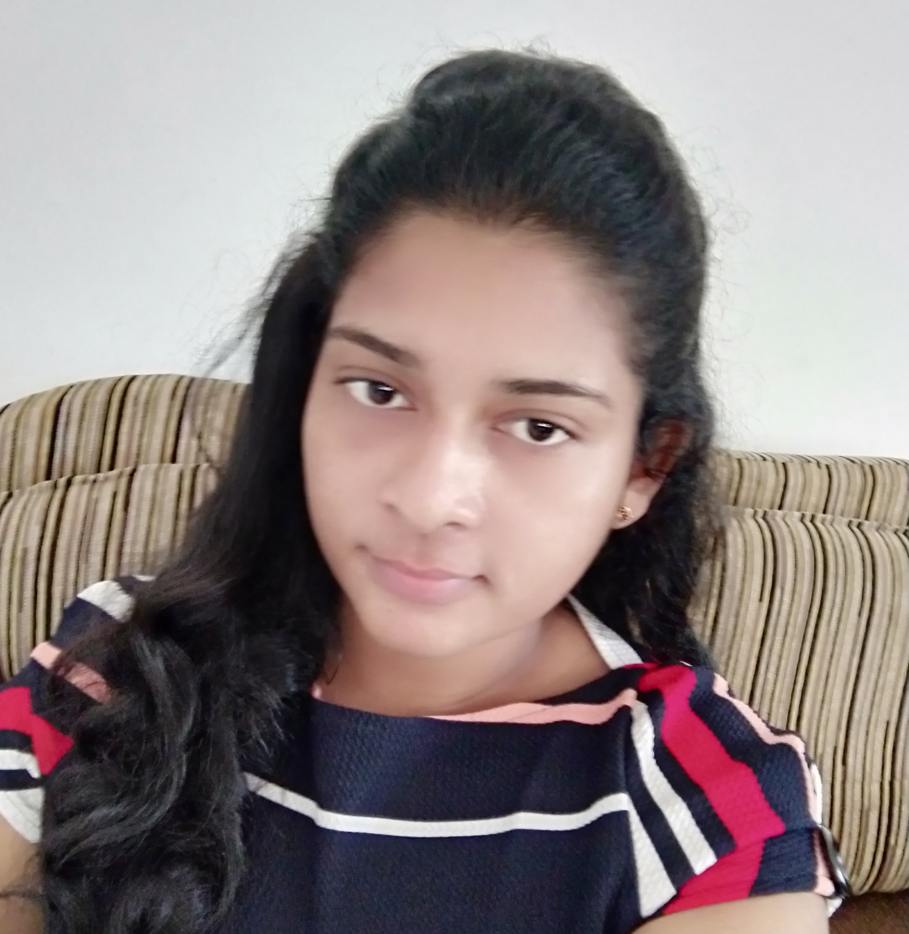

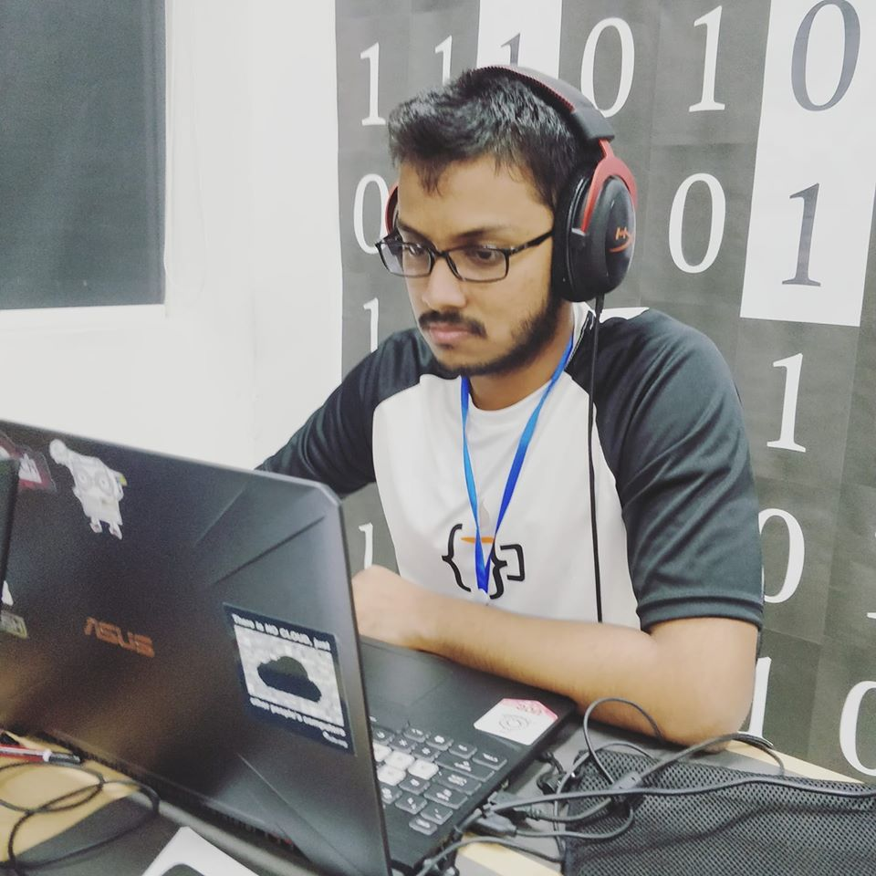
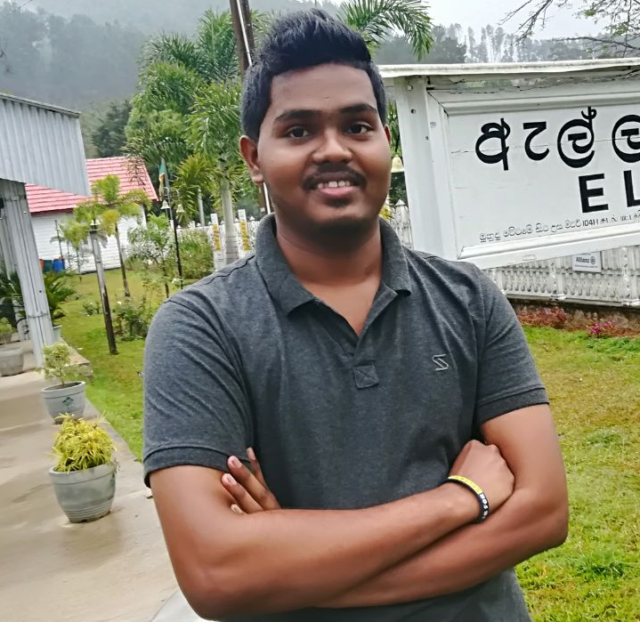
Team CS 37
W.M.D.M.Y. Wickramanayaka
T.W.T. Dulshan
U.W.T.O Weerasinghe
W.K.B.K. Madhushanka
2018/CS/192
2018/CS/048
2018/CS/191
2018/CS/096

Slide 3
TABLE OF CONTENTS
01
02
03
04
05
06
INTRODUCTION
ROLES OF THE SYSTEM
DIAGRAMS
PROJECT PROGRESS
TECHNOLOGIES
DEMONSTRATION

Slide 4


INTRODUCTION TO SYSTEM
Online Reservation
View vacant time slot online
Leave Management of employees
Online Advanced Payment
A simple web application reservation system + leave managing system for car service stations
04

Slide 5


INTRODUCTION TO SYSTEM
Clean Car : An online vehicle reservation system + leave applying system for a vehicle service
Reduce the time wasted by customers at the service station and reduce the constant working hours of employees through an online reservation system.
Maintain an electronic database instead of traditional paper cabinets.
05

Slide 6
Functionalities for each role:
Scope
Vehicle service customers (main target)
Employees
Online reservation system
Reservation through smart calendar
(through times displayed publicly
in the calendar)
Cancel / Update reservations
Online advance payment System
Employee leave management system
Apply leave through smart calendar
Can cancel before conditional date
View summary of leaves taken during
a month
06

Slide 7
Scope
System handler (Receptionist)
Manager (Admin)
Online reservation system
Reservation through smart calendar
for customers manually
Cancel / Update reservations based on
customer calls
Add/Update employee records
Accept /Reject employee leaves
Generate reports
Can view summary of following
Employee leaves
Reservations per service type
Number of Cancelled reservations
Has access to all administrative functions
07

Slide 8
Out-Scope
The System will not cover aspects related to salary calculation, stock management or promo code generation.
08

Slide 9

BUSINESS MODEL
All data related to service types, prices can be tailor made according to the need of the service station.
All terms and conditions related to advance reservation and advance payment will be made according to the suite .
The advance payment will be a reasonable amount depending on that particular service station and will be deducted from the final bill.
09

Slide 10
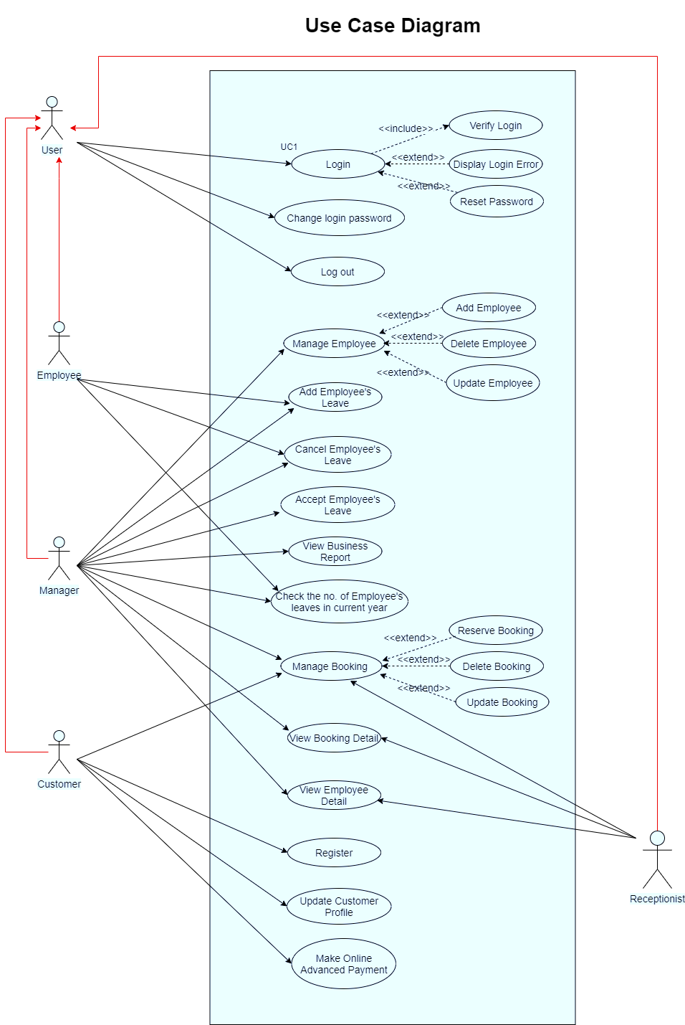
Use case diagram
10

Slide 11
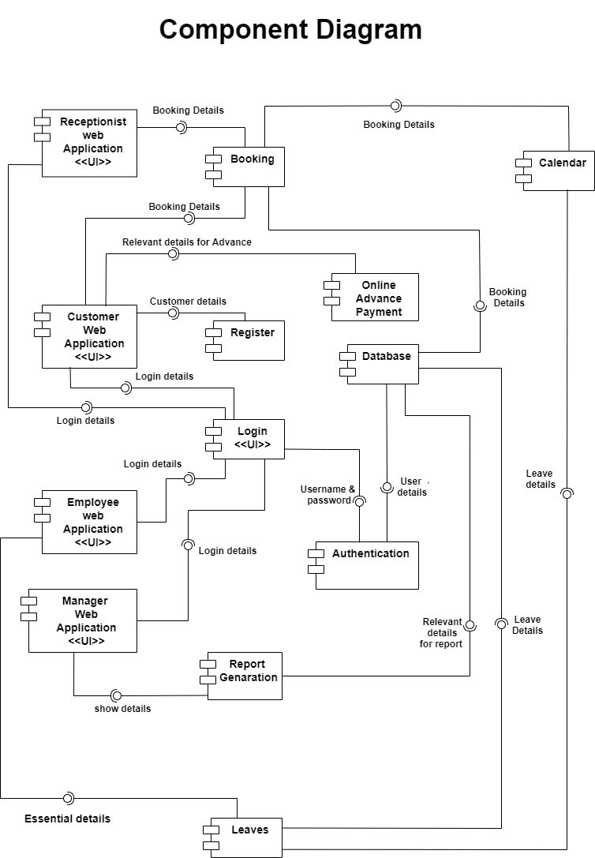
Component diagram (High level architecture)
11

Slide 12
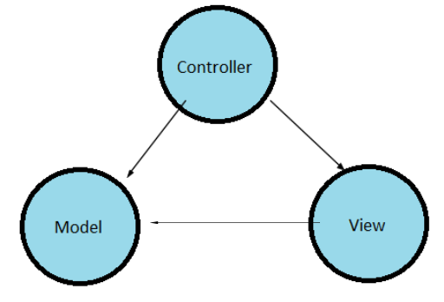
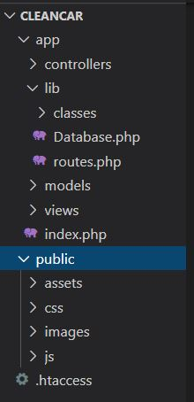
Architecture:
MVC (Model , View , Controller)
Why?
Simultaneous development — Multiple developers can work simultaneously on the model, controller and views.
Ease of modification — Because of the separation of responsibilities, future development or modification is easier
Scalability of the product is increased.
Multiple views for a model — Models can have multiple views.
12

Slide 13
Workload Distribution
U.W.T.O Weerasinghe | Role – Customer Adding Routes Email component integration (PHPMailer) Session Management
T.W.T. Dulshan | Role – Receptionist Table Designing Component diagram
W.M.D.M.Y. Wickramanayaka | Role – Employee Database and ER design Profile
W.K.B.K. Madhushanka | Role – Manager Home , About Us, Contact Us pages Navigation bar and Footer
13

Slide 14
Project Progress
14

Slide 15
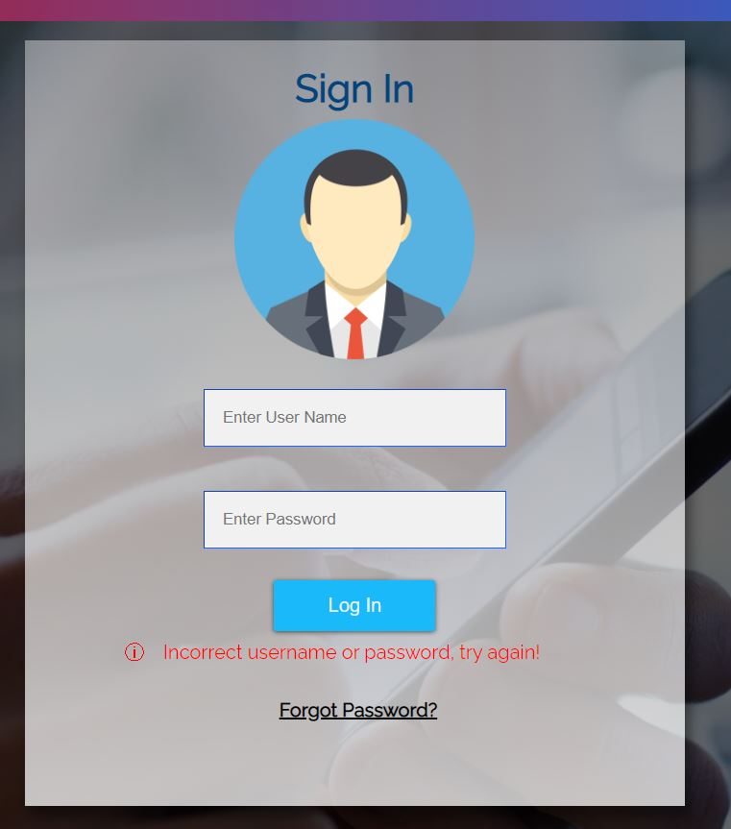
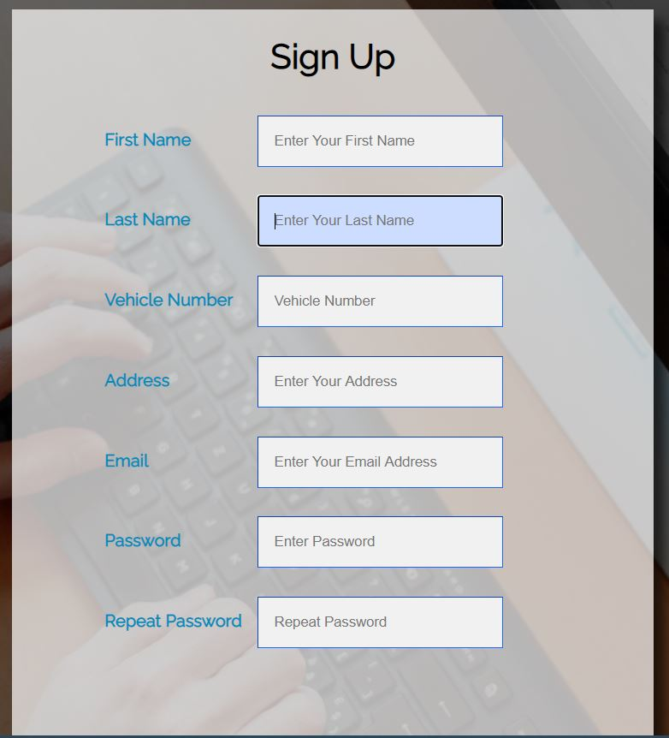
Completed tasks
Login and authentication with sessions for all users
15

Slide 16
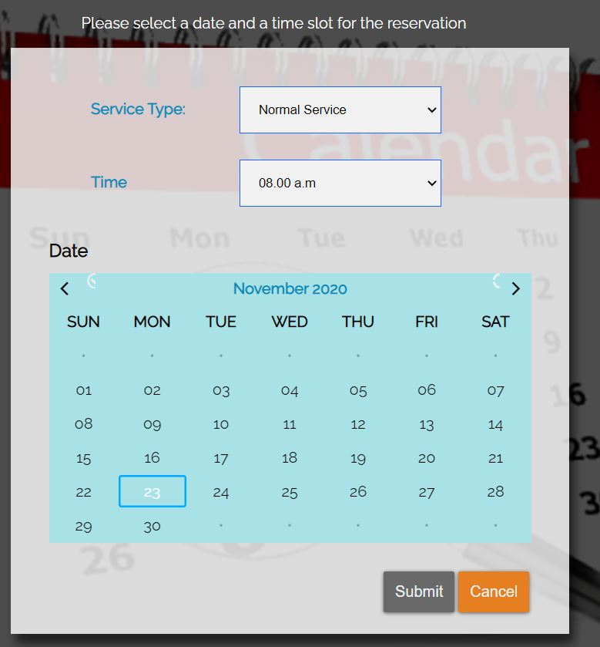
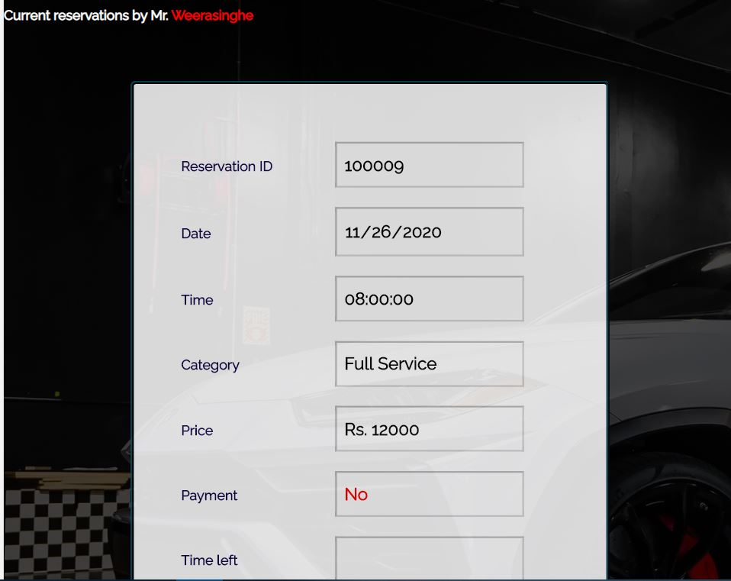
Completed tasks
Customer - U.W.T.O Weerasinghe
Make Reservation | View Reservations
16

Slide 17
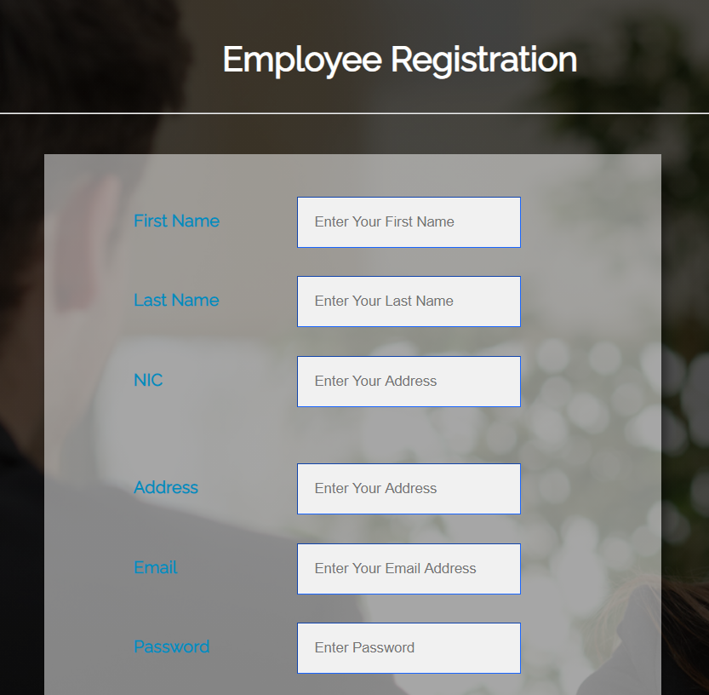
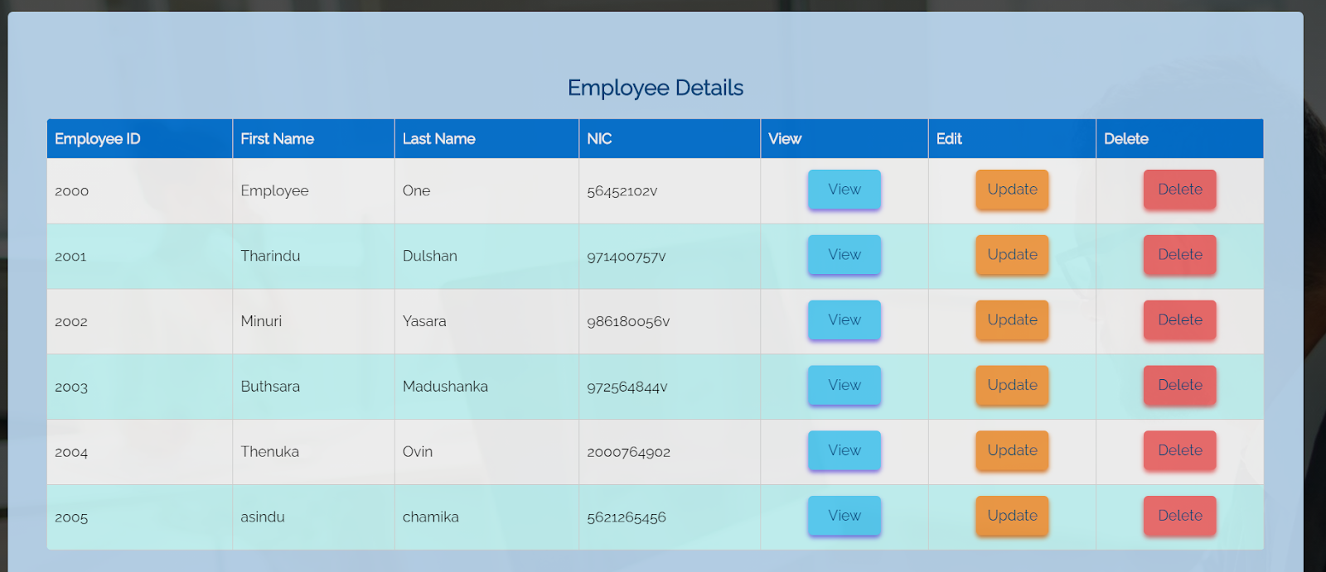
Completed tasks
Receptionist - T.W.T. Dulshan
Add Employee | View Employee
17

Slide 18
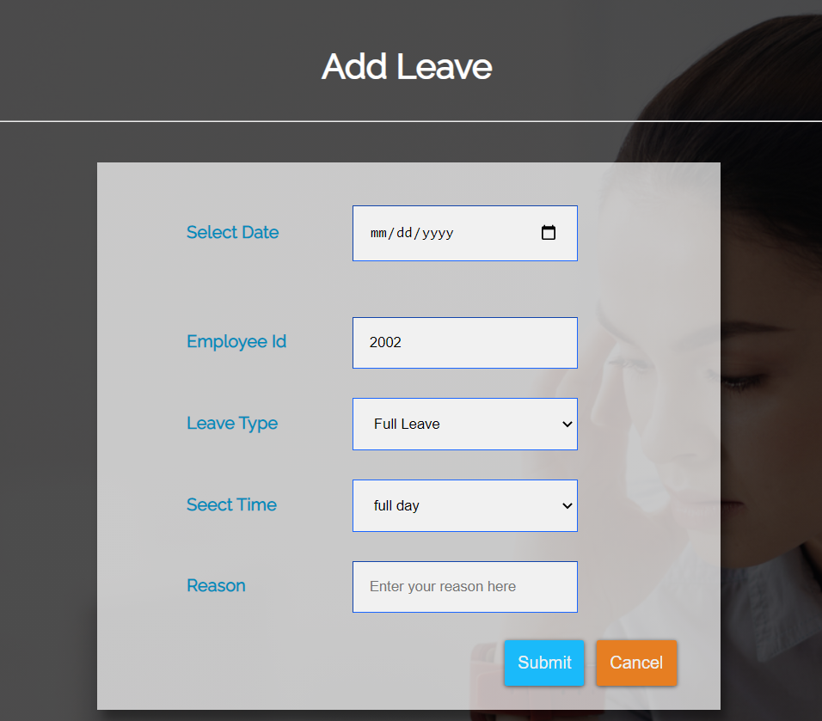
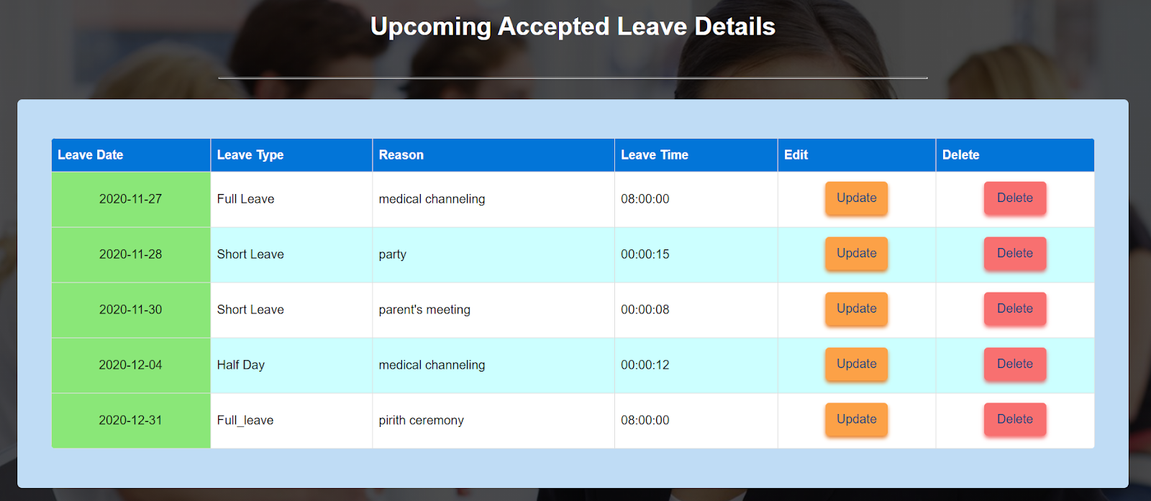
Employee - W.M.D.M.Y. Wickramanayaka
Add Employee leave | View Employee leave
18

Slide 19
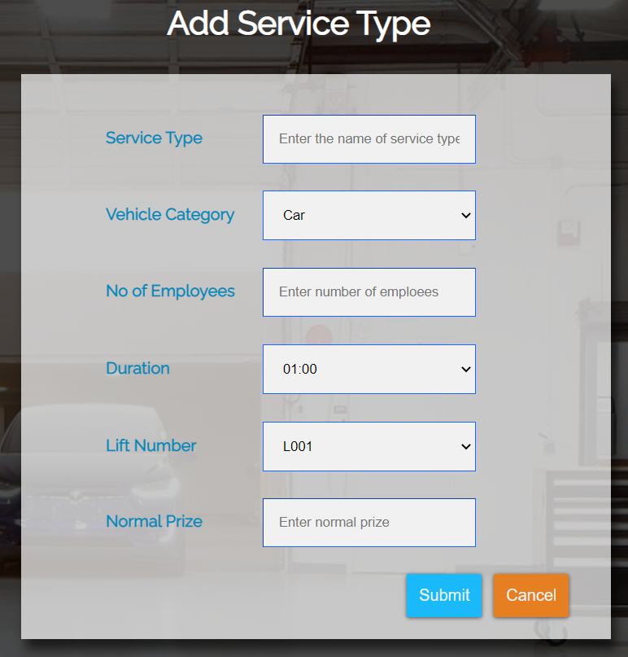
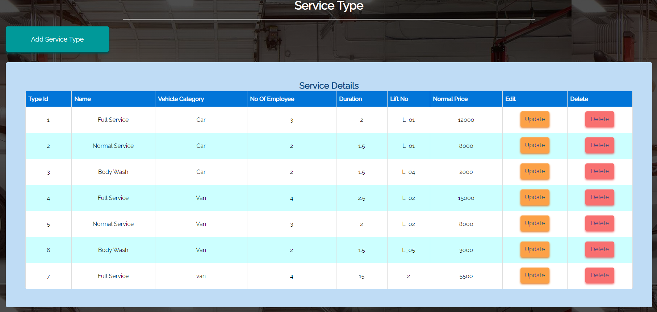
Manager - W.K.B.K. Madhushanka
Add Service type | View Service Type
19

Slide 20

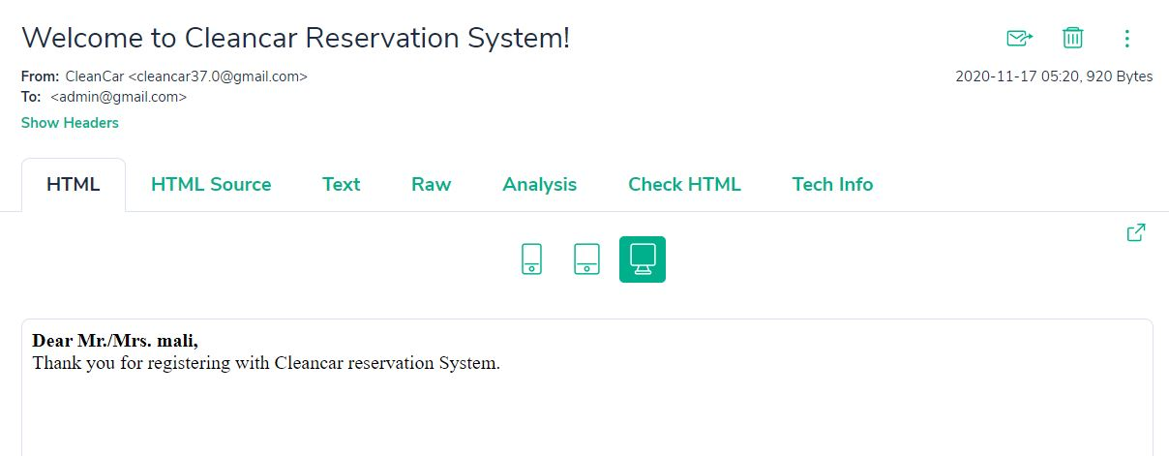
Other tasks completed:
PHP Mailer e-mail notification integration:
For each new customer registration
For new employee registration
Forgot password notification
20

Slide 21
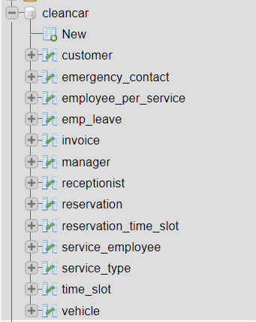

Other tasks completed:
Session management for users
Database construction with constraints
21

Slide 22
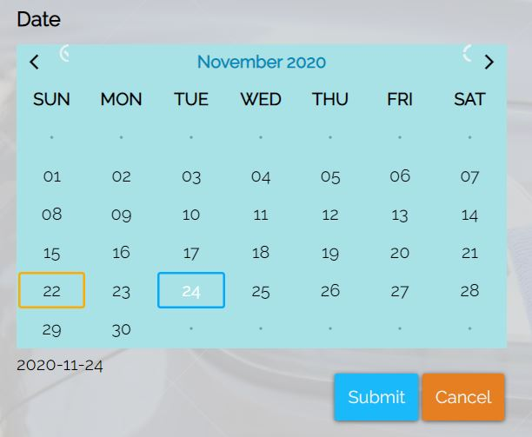
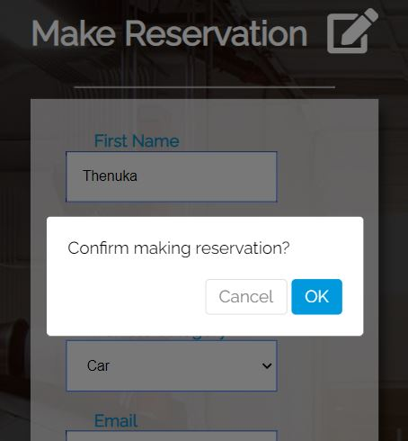
Ongoing tasks
Confirmation alerts and messages
Smart calendar for reservation
For car wash reservations
Employee leaves
22

Slide 23


To-do tasks
Scheduler for vehicle reservations
Vehicle category validation from vehicle no.
Confirmation dialogue boxes for all operations.
SMS notification component
Advance Payment Module for Reservations
23

Slide 24
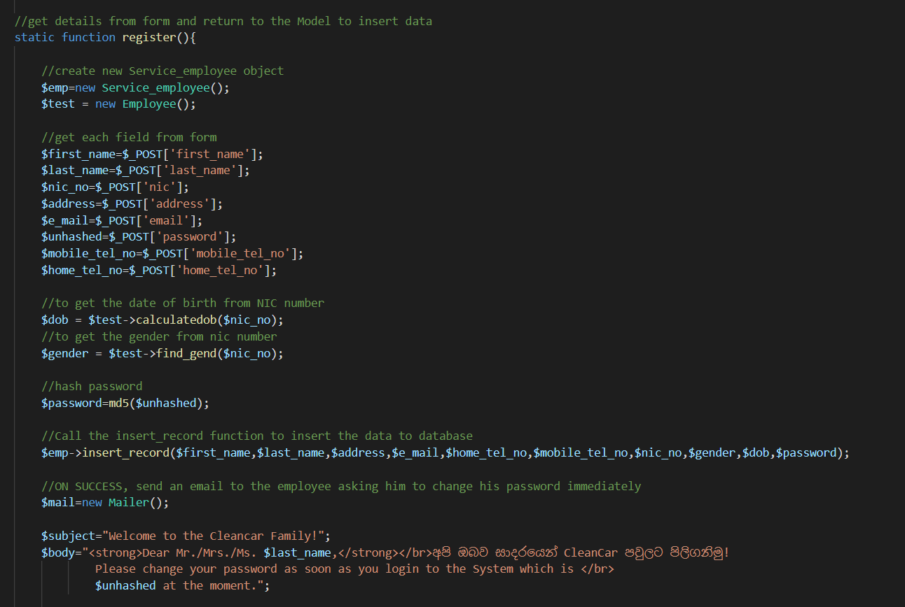
Best Practices
Commenting in a standardized manner throughout
Following a good naming convention throughout the code,
Php variable - snake_case
Php class names – first letter is capital
Using version controlling repositories from the beginning of the project (Github)
24

Slide 25
Technologies

Slide 26





Programming Languages | Php, SQL, JavaScript
Markup ,scripting languages , libraries | HTML, CSS , JQuery
Database | MYSQL
UI/UX Implementation | Balsamiq, Adobe Photoshop
Other Extensions | PHPMailer, Nexmo , PayHere
Diagramming and version control | Draw.io, Github
Communication and planning | Trello, Discord

Slide 27
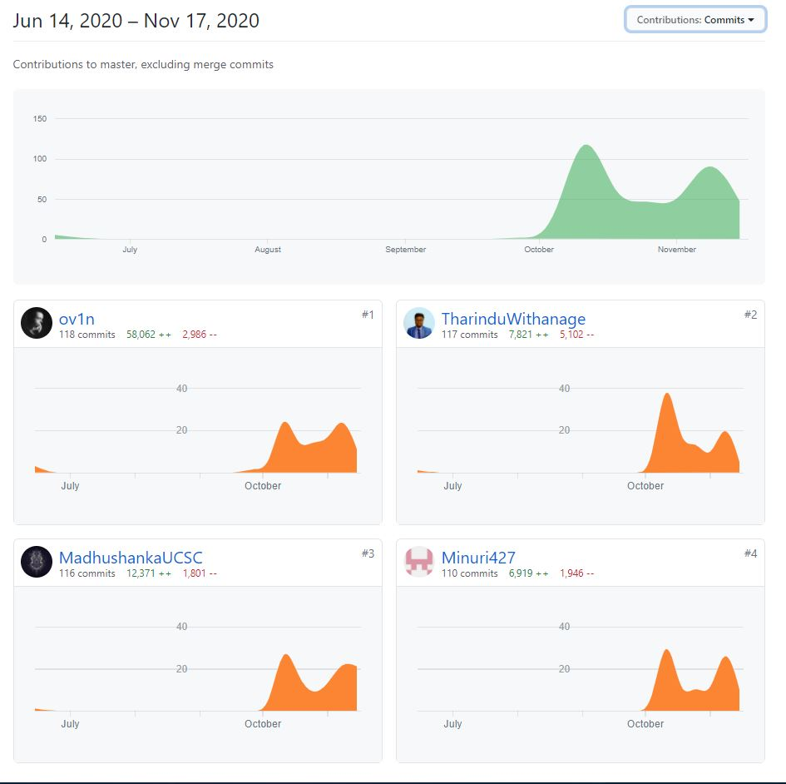

Work Plan
Version Controlling and
contributions
https://github.com/ov1n/Cleancar
Discord for communication
27

Slide 28
Testing
Unit Testing
Integration Testing
System Testing
Regression Testing
All testing will be done manually without using automated tools
28

Slide 29
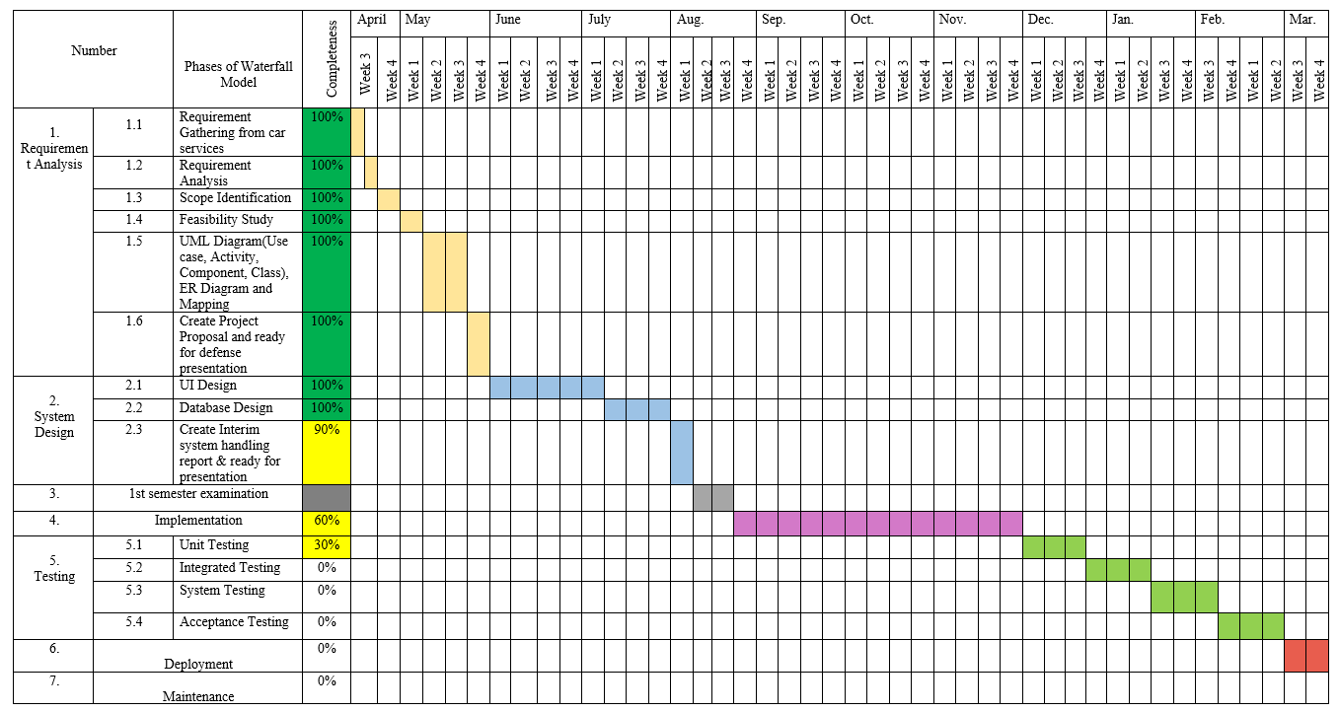
Work Plan
Gantt chart
29

Slide 30

Demonstration

Slide 31
Q & A

Slide 32
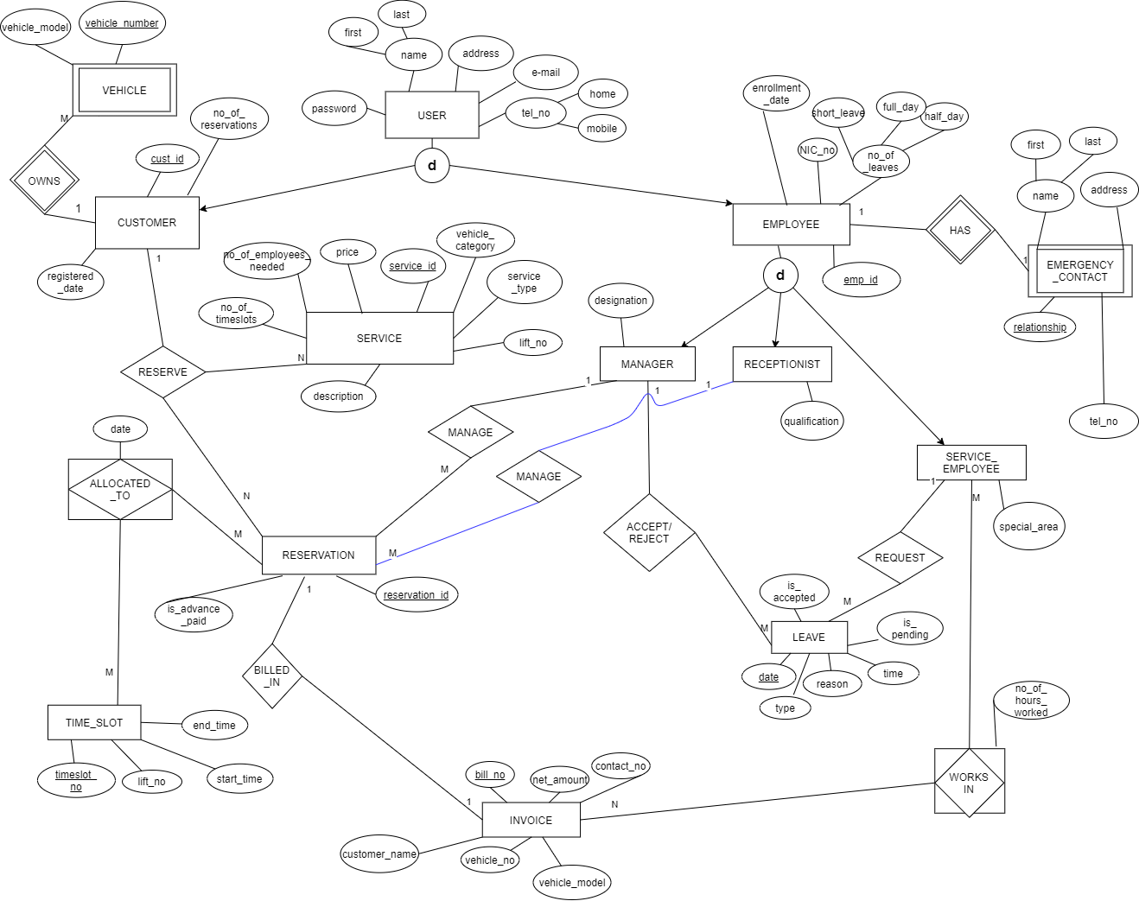
ER Diagram
32

Slide 33
Appendix
ER mapping changes
SERVICE_EMPLOYEE
emp_id | first_name | last_name | address |  | e-mail |  |  | home_tel_no |  | mobile_tel_no | NIC_no
no_of_leaves_short |  | no_of_leaves_halfday |  |  |  | no_of_leaves_fullday |  |  |  | enrollment_date
Special_area |  | password |  | gender |  |  | birthday
33

Slide 34
INVOICE
RESERVATION
SERVICE_TYPE
Invoice_no | bill_no | customer_name |  | vehicle_no |  | vehicle_model | contact_no
bill_date | reservation_id (FK) |  | net_amount
reservation_id | is_advance_paid | cust_id (FK) | service_id (FK) | added_date
type_id | type_name |  | price | vehicle_category | lift_no | duration
no_of_employees
34

Slide 35
RESERVATION-TIME_SLOT
EMP_LEAVE
VEHICLE
reservation_id(FK) | timeslot_no(FK) | date
35

Slide 36
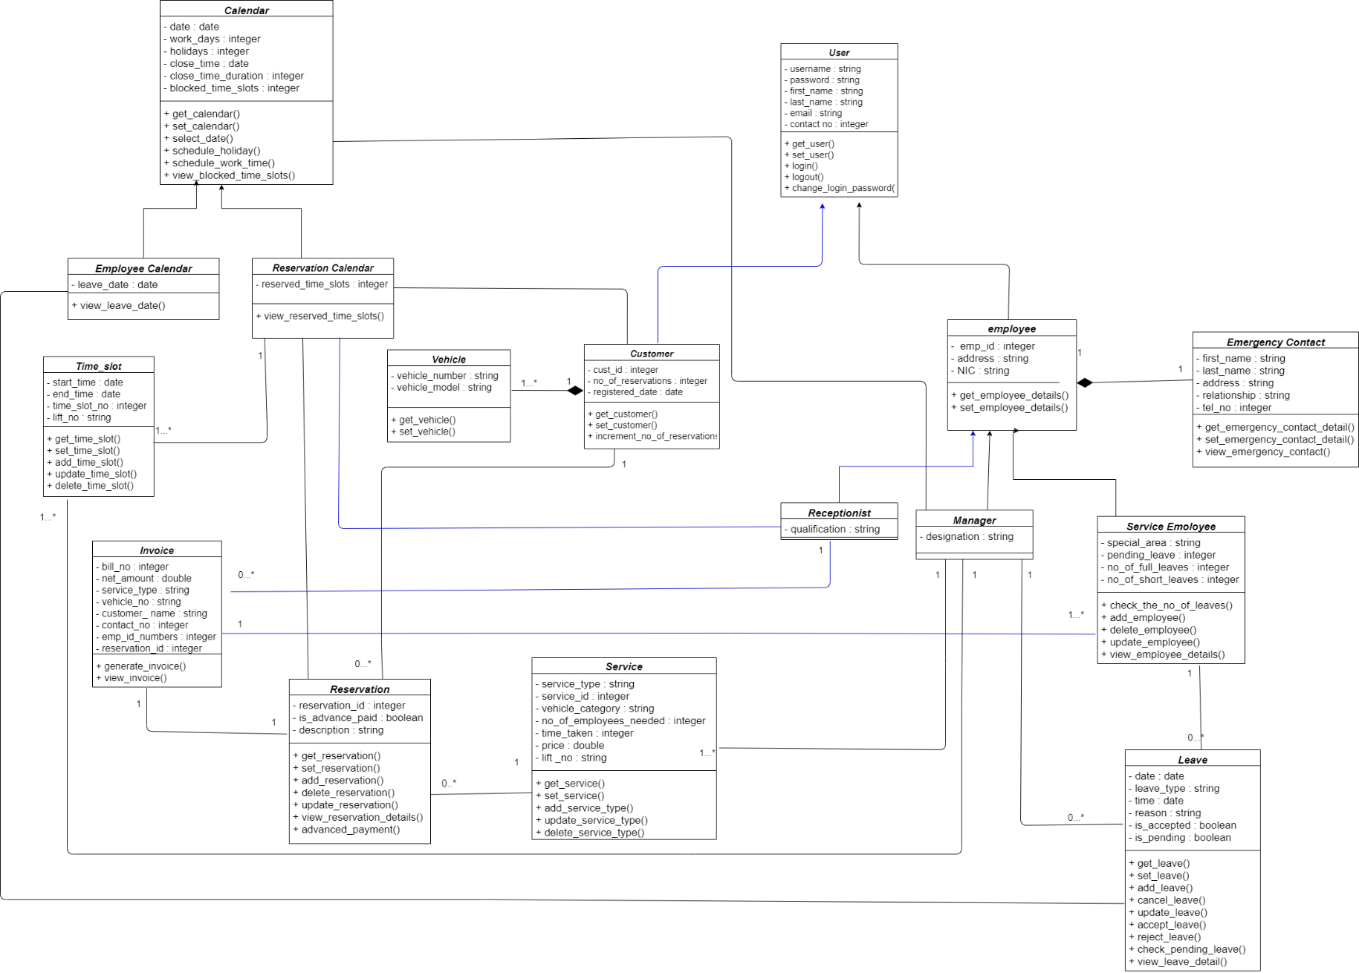
Class Diagram
36

